Slide 1
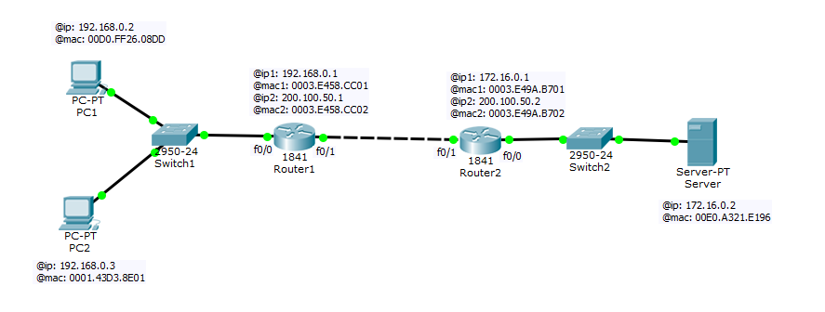
Trame: @IP emt @ IP dst @mac emt @mac dst …
00D0.FF26.08DD 0003.E458.CC01
(pc1) (Router1_mac1)
192.168.0.2 192.168.0.3 00D0.FF26.08DD 0001.43D3.8E01
(pc1) (pc2) (pc1) (pc2)
192.168.0.2 172.16.0.2
(pc1) (Serveur)
0003.E458.CC02 0003.E49A.B701
(Router1_mac2) (Router2_mac1)
0003.E49A.B702 00E0.A321.E196
(Router2_mac2) (Serveur)

